Slide 1
SECTION 1: DIODES
ECE 322 – Electronics I

Slide 2
Course Overview
2

Slide 3
Course Overview
3
Your previous electrical engineering courses focused on circuits containing:
◉ Sources
  Voltage and current
  Independent and dependent
◉ Passive devices
  Resistors, capacitors, inductors
◉ Opamps
  Integrated circuits (ICs)
  Semiconductor devices
  Comprised of transistors
In this course, our focus will be on semiconductor devices:
◉ Diodes
◉ Transistors

Slide 4
Course Overview
4
We will learn to analyze and design circuits using semiconductor devices – diodes and transistors
Our primary focus will be discrete, analog circuits
Discrete circuits:
◉ Built using individual discrete components (transistors, diodes, Rs, Ls, Cs)
◉ Not integrated circuits (ICs), though we will be laying the foundation for IC design
Analog circuits:
◉ Voltages/currents can vary continuously
◉ As opposed to digital circuits, where quantities can only assume discrete values

Slide 5
Course Overview
5
Section 1: Diodes  Introduction to semiconductors  Rectifier circuits
Section 2: Bipolar Junction Transistors  Device characteristics and models
Section 3: BJT Amplifiers  Various amplifier circuits using BJTs
Section 4: MOSFETs  Device characteristics and models
Section 5: MOSFET Amplifiers  Various amplifier circuits using MOSFETs
Section 6: Integrated Circuit Building Blocks  Intro to basic components of integrated circuits

Slide 6
Diode Fundamentals
6

Slide 7
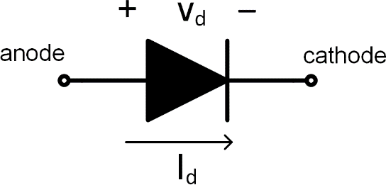


Diodes
7
Two terminal electrical components that allow current to flow in one direction only
◉ Current can flow from anode to cathode, but not from cathode to anode
◉ Analogous to check valves
Fluid can flow in one direction only:

Slide 8
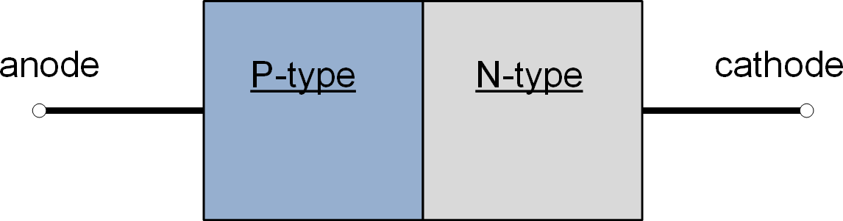

Diodes – PN Junctions
8
Diodes are semiconductor devices
◉ Formed from the junction of two dissimilar semiconductor materials
  P-type and N-type semiconductors
◉ P-N junctions:

Slide 9
Semiconductor Fundamentals
9

Slide 10
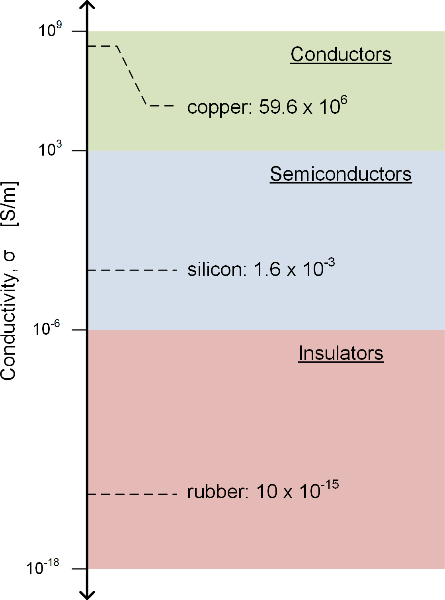
Semiconductors
10
Semiconductors have conductivities between those of conductors and insulators
Conductivity can be modified by adding impurities
◉ Doping

Slide 11
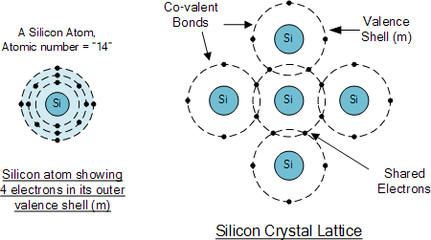
Semiconductors
11
Semiconductors have four valence electrons
◉ Valence bands are half full
◉ Atoms bond together in a crystalline lattice structure
◉ Each atom shares covalent bonds with four adjacent atoms
◉ Few free charge carriers – poor conductivity
Image source: https://www.electronics-tutorials.ws

Slide 12
Semiconductors – Doping
12
Intrinsic semiconductors are poor conductors
Conductivity can be altered by adding impurities
through a process called doping
Doping: addition of a small amount of another element to the intrinsic semiconductor
◉ Low concentration: 10 ppb – 100 ppm
◉ Free charge carriers are increased
◉ Conductivity is increased
Type of dopant determines type of semiconductor
◉ N-type or P-type
K. Webb
ECE 322

Slide 13
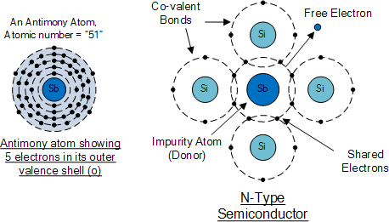
Semiconductors – N-Type
13
N-type material created by doping with pentavalent dopant atoms
◉ Five valence electrons
◉ E.g., phosphorous (P) or antimony (Sb)
◉ Bonding with four Si atoms creates a free electron
◉ Dopants are called donors – they donate free electrons
Image source: https://www.electronics-tutorials.ws

Slide 14
Semiconductors – N-Type
14
Donor atoms lose an electron
◉ These free electrons are majority carriers
There will be some holes as well
◉ Thermally-generated
◉ Much lower concentration – minority carriers
Image source: https://www.electronics-tutorials.ws

Slide 15
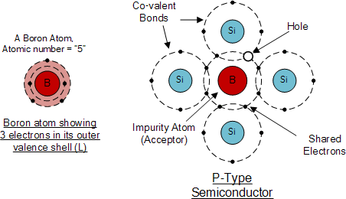
Semiconductors – P-Type
15
P-type material created by doping with trivalent dopant atoms
◉ Three valence electrons
◉ E.g., Boron (B)
◉ Bonding with four Si atoms creates a hole
◉ Dopants are called acceptors – they accept an electron from a Si atom
Image source: https://www.electronics-tutorials.ws

Slide 16
Semiconductors – P-Type
16
Acceptor atoms introduce a hole
◉ These holes are majority carriers
There will be some free electrons as well
◉ Thermally-generated
◉ Much lower concentration – minority carriers
Image source: https://www.electronics-tutorials.ws

Slide 17
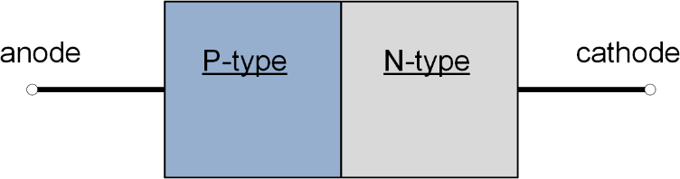

P-N Junctions
17
P-N junctions – diodes – are formed by joining P-type and N- type semiconductors
P-type on one side of the junction
◉ Majority carriers: holes – mobile positive charge
N-type on the other
◉ Majority carriers: electrons – mobile negative charge
At the junction:
◉ Holes want to diffuse across into the N-type material
◉ Electrons want to diffuse across into the P-type material

Slide 18
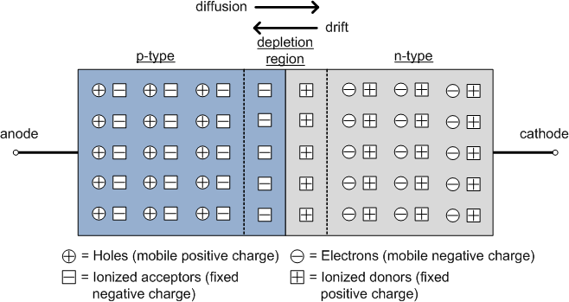
P-N Junctions
18
Mobile holes want to diffuse from p-type to n-type
Mobile electrons want to diffuse from n-type to p-type
Space-charge layer or depletion region is created
Diffusion drives negative charge one way, positive charge the other

Slide 19
P-N Junctions
19
Diffusion causes a charge gradient across the junction
◉ Electric field established
E-field drives mobile charge back in the opposite direction
◉ Drift opposes and limits diffusion

Slide 20
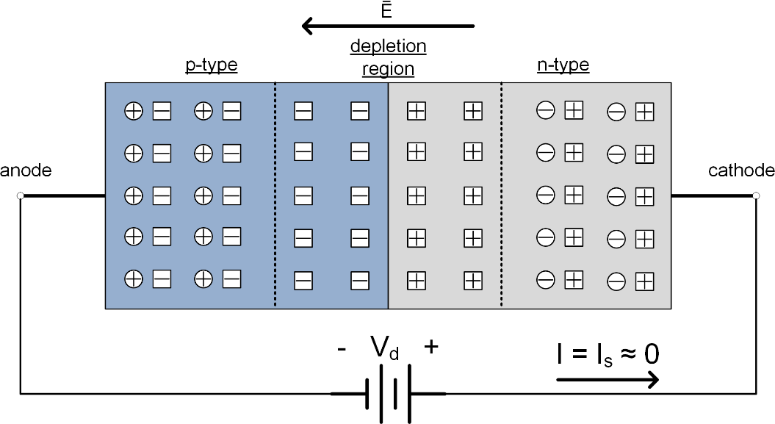
P-N Junction – Reverse Bias
20
Reverse-bias voltage applied – V_{d} < 0 V
◉ Applied voltage adds to depletion region E-field
◉ Additional diffusion to balance larger E-field
◉ Depletion region expands
◉ Negligible reverse current flow due to drift of thermally- generated minority carriers

Slide 21
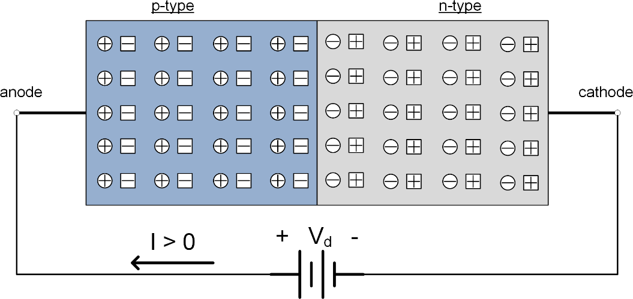
P-N Junction – Forward Bias
21
Forward-bias voltage applied – V_{d} > 0 V
◉ Applied voltage reduces depletion region E-field
◉ Depletion region shrinks
Significant forward current flows
◉ Majority carriers diffuse across the junction
◉ Carried to diode terminals by applied E-field

Slide 22
Diode I-V Characteristics
22

Slide 23
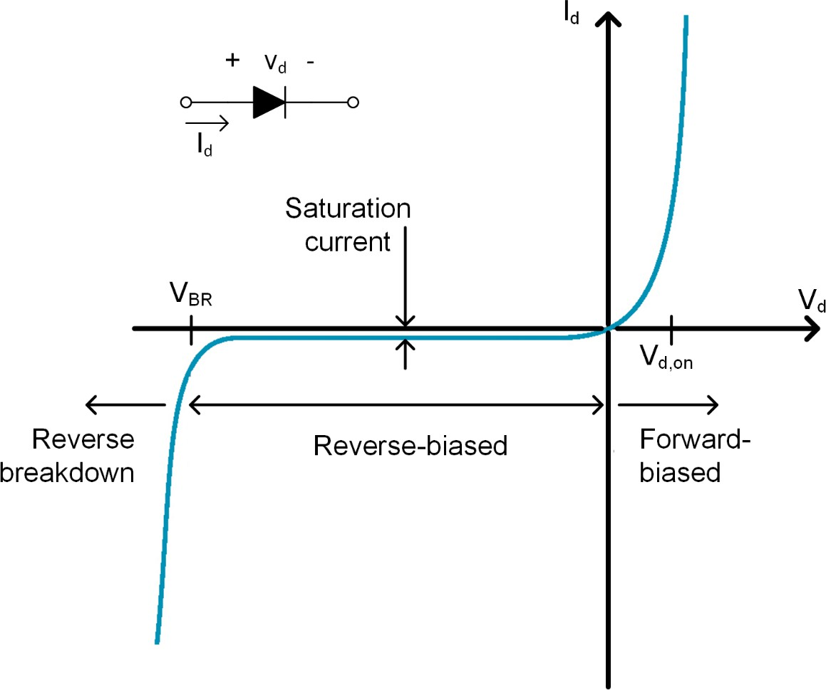
Diode I-V Characteristics
23
Three operating regions:
◉ Forward biased
  V_{d} > 0 V
  Current flows from anode to cathode
◉ Reverse biased
  V_{d} < 0 V
  Negligible, nearly- constant saturation current, I_{s}, flow from cathode to anode
◉ Reverse breakdown
  V_{d} < V_{BR}
  Large reverse current flows

Slide 24
Shockley Equation
24
In the forward- and reverse-biased regions, diode behavior can be approximated by the Shockley Equation:
𝑉𝑉_{𝑑𝑑}
𝐼𝐼_{𝑑𝑑} = 𝐼𝐼_{𝑠𝑠} 𝑒𝑒^{𝑉𝑉𝑡𝑡𝑡} − 1
◉ 𝑉𝑉_{𝑡𝑡𝑡} is the thermal voltage
𝑘𝑘𝑘𝑘
𝑉𝑉_{𝑡𝑡𝑡} = _{𝑞𝑞}
  𝑘𝑘 = 1.38 × 10⁻²³𝐽𝐽/𝐾𝐾 is Boltzmann’s constant
  𝑞𝑞 = 1.6 × 10⁻¹⁹ 𝐶𝐶 is the charge of an electron
  At 𝑘𝑘 = 300 𝐾𝐾, 𝑉𝑉_{𝑡𝑡𝑡} ≈ 26 𝑚𝑚𝑉𝑉
◉ 𝐼𝐼_{𝑠𝑠} is the saturation current
  Typically very small, e.g., 𝐼𝐼_{𝑠𝑠} ≈ 35 𝑝𝑝𝑝𝑝

Slide 25

Shockley Equation
25
𝑉𝑉_{𝑑𝑑}
𝐼𝐼_{𝑑𝑑} = 𝐼𝐼_{𝑠𝑠} 𝑒𝑒^{𝑉𝑉𝑡𝑡𝑡} − 1
In forward bias, the −𝐼𝐼_{𝑠𝑠}
term is negligible
◉ Exponential current- voltage relationship
𝑉𝑉_{𝑑𝑑}
𝐼𝐼_{𝑑𝑑} ≈ 𝐼𝐼_{𝑠𝑠}𝑒𝑒^{𝑉𝑉𝑡𝑡𝑡}
In reverse bias, the exponential term is negligible
◉ Nearly-constant, and small, reverse current
𝐼𝐼_{𝑑𝑑} ≈ −𝐼𝐼_{𝑠𝑠}

Slide 26
Reverse Breakdown
26
Shockley equation does not describe reverse- breakdown behavior
Typical Breakdown voltages are in the range of a few volts to hundreds of volts
Typically, we want to avoid exceeding the breakdown voltage
However, one class of diodes is designed to be used in breakdown: Zener diodes

Slide 27

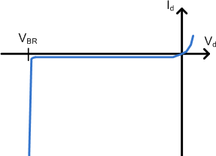
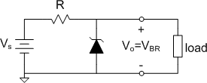
Zener Diodes
27
Zener diodes designed to have a very steep I-V characteristic in the breakdown region
◉ V_{d} is almost constant, independent of current
◉ Useful in voltage regulation or voltage reference circuits
◉ Schematic symbol:
V_{d} nearly constant in breakdown

Slide 28
Diode Models
28

Slide 29
Diode Models
29
Need a diode model to enable circuit analysis
Shockley equation is one model
◉ Simplified, but still complex for hand analysis
Can trade off complexity and accuracy
◉ Choose the simplest possible model that provides acceptable accuracy
We’ll look at three much simpler models
◉ Appropriate for first-order type of analyses
  Ideal diode model
  Nearly-ideal diode model
  Nearly-ideal model with resistance

Slide 30
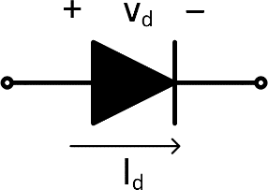

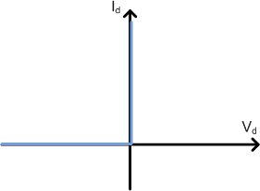

Ideal Diode Model
30
Ideal diode model:
◉ Short circuit for forward-bias current
◉ Open circuit for reverse-bias voltage
Forward-bias equivalent circuit:
Forward current flows
V_{d} = 0 V
◉ V_{d} = 0 V
◉ I_{d} > 0 A
Reverse-bias circuit:
I_{d} = 0 A for V_{d} < 0 V
◉ V_{d} < 0 V
◉ I_{d} = 0 A

Slide 31

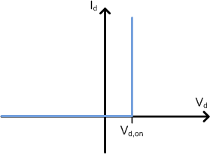
Nearly-Ideal Diode Model
31
Nearly-ideal diode model:
◉ Accounts for diode forward voltage
◉ Open circuit for V_{d} < V_{d,on}
Forward-bias equivalent circuit:
◉ V_{d} = V_{d,on} ≈ 700 mV
◉ I_{d} > 0 A
Reverse-bias circuit:
I_{d} = 0 for ^{V}d ^{< V}d,on
Id > 0 A
Vd = V
d,on
◉ V_{d} < V_{d,on} ≈ 700 mV
◉ I_{d} = 0 A

Slide 32

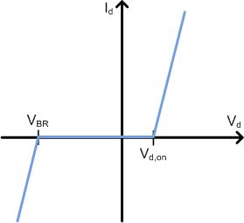

Nearly-Ideal Model with Resistance
32
Add resistance to the nearly-ideal model
◉ Account for real parasitic resistance, or
◉ Provide a better fit to the diode’s I-V curve
Forward-bias circuit:
◉
^{V}d ^{= V}d,on ^{+ I}d^{∙R}on
Slope = 1/R
Reverse-bias circuit:
Reverse breakdown:
on
Slope = 1/R_{BR}
◉ V_{d} = -V_{BR} + I_{d}∙R_{BR}

Slide 33
Load-Line Analysis
33

Slide 34
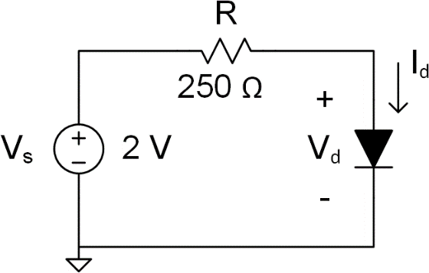
Diode Circuit Analysis
34
Analyze the circuit to find the diode operating point: 𝑉𝑉_{𝑑𝑑} and 𝐼𝐼_{𝑑𝑑}
Apply KVL around the circuit
𝑉𝑉_{𝑠𝑠} − 𝐼𝐼_{𝑑𝑑} 𝑅𝑅 − 𝑉𝑉_{𝑑𝑑} = 0
(1)
One equation with two unknowns: 𝑉𝑉_{𝑑𝑑} and 𝐼𝐼_{𝑑𝑑}
◉ Shockley equation give 𝐼𝐼_{𝑑𝑑} in terms of 𝑉𝑉_{𝑑𝑑}
𝑉𝑉_{𝑑𝑑} 𝑉𝑉_{𝑑𝑑}
𝐼𝐼_{𝑑𝑑} = 𝐼𝐼_{𝑠𝑠} 𝑒𝑒^{𝑉𝑉𝑡𝑡𝑡} − 1 ≈ 𝐼𝐼_{𝑠𝑠}𝑒𝑒^{𝑉𝑉𝑡𝑡𝑡}
(2)
Substituting (2) into (1) yields a transcendental equation
𝑉𝑉_{𝑑𝑑}
𝐼𝐼_{𝑠𝑠}𝑒𝑒^{𝑉𝑉𝑡𝑡𝑡} ⋅ 𝑅𝑅 + 𝑉𝑉_{𝑑𝑑} = 𝑉𝑉_{𝑠𝑠}
◉ Solve via iteration, or
◉ Solve graphically – load-line analysis
(3)

Slide 35
Diode Circuit Analysis
35
𝑉𝑉_{𝑑𝑑}
𝐼𝐼_{𝑠𝑠}𝑒𝑒^{𝑉𝑉𝑡𝑡𝑡} ⋅ 𝑅𝑅 + 𝑉𝑉_{𝑑𝑑} = 𝑉𝑉_{𝑠𝑠} (3)
Solving (3) amounts to solving the system of two equations given by (1) and (2)
𝐼𝐼 = − ^{𝑉𝑉𝑑𝑑} + ^{𝑉𝑉𝑠𝑠}
(1)
𝑑𝑑
𝑅𝑅 𝑅𝑅
𝑉𝑉_{𝑑𝑑}
𝐼𝐼_{𝑑𝑑} = 𝐼𝐼_{𝑠𝑠}𝑒𝑒^{𝑉𝑉𝑡𝑡𝑡}
◉ Equation (1) is an equation for a line – the load line
◉ Equation (2) is the exponential forward-biased diode characteristic
(2)
Solution is the values of 𝑉𝑉_{𝑑𝑑} and 𝐼𝐼_{𝑑𝑑} that satisfy both equations
◉ Point where the two curves intersect
◉ The DC operating point
Finding this solution graphically is load-line analysis

Slide 36
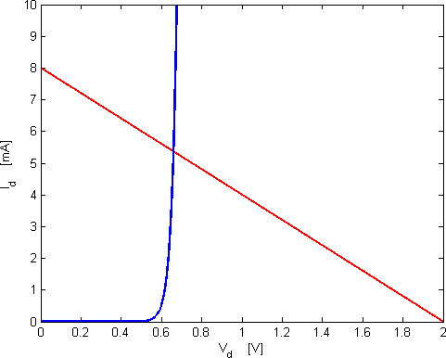
Load-Line Analysis
36
V_{d} = 0
I_{d} = V_{s}/R = 8mA
Diode Load-Line Analysis
Diode I-V characteristic
DC operating point:
V_{d} ≈ 660mV
I_{d} ≈ 5.4mA
I_{d} = 0
V_{d} = V_{s} = 2V

Slide 37
Analysis with Simple Diode Models
37

Slide 38
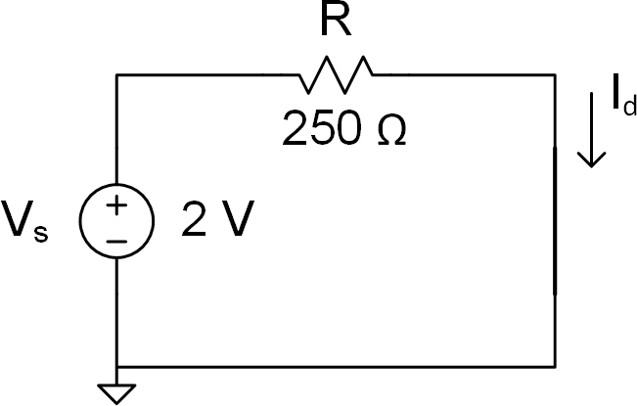
Simplified Analysis – Ideal Model
38
Revisit the previous analysis using the
ideal diode model
Diode is forward biased
◉ Replace with a short circuit
Diode modeled as a short, so
𝑉𝑉_{𝑑𝑑} = 0 𝑉𝑉
Ohm’s law gives current
𝑉𝑉_{𝑠𝑠} 2 𝑉𝑉
𝐼𝐼 = = = 8 𝑚𝑚𝑝𝑝
𝑑𝑑
𝑅𝑅 250 Ω
Current is in correct order of magnitude, but not very accurate
Next, try the nearly-ideal model

Slide 39

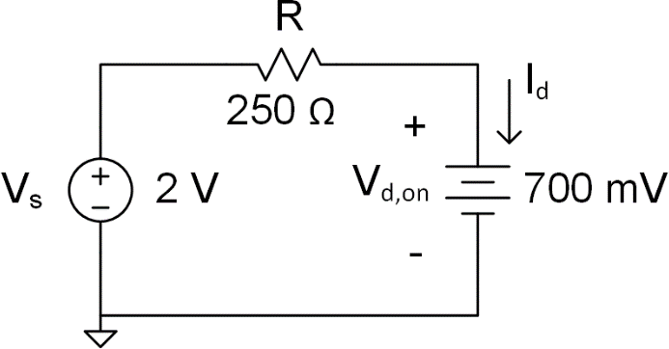
Simplified Analysis – Nearly-Ideal Model
39
Now, use the nearly-ideal model
Diode is forward biased
◉ Replace with a voltage source
◉ In practice, would have some idea of the appropriate value for 𝑉𝑉_{𝑑𝑑,𝑜𝑜𝑜𝑜}
𝑉𝑉_{𝑑𝑑} = 𝑉𝑉_{𝑑𝑑,𝑜𝑜𝑜𝑜} ≈ 700 𝑚𝑚𝑉𝑉
Ohm’s law gives current
𝑉𝑉_{𝑠𝑠} − 𝑉𝑉_{𝑑𝑑,𝑜𝑜𝑜𝑜} 2 𝑉𝑉 − 0.7 𝑉𝑉
= = = 5.2 𝑚𝑚𝑝𝑝
𝑅𝑅 250 Ω
𝐼𝐼
𝑑𝑑
Much more accurate result
This is our go-to model for hand analysis

Slide 40
Rectifier Circuits
40

Slide 41
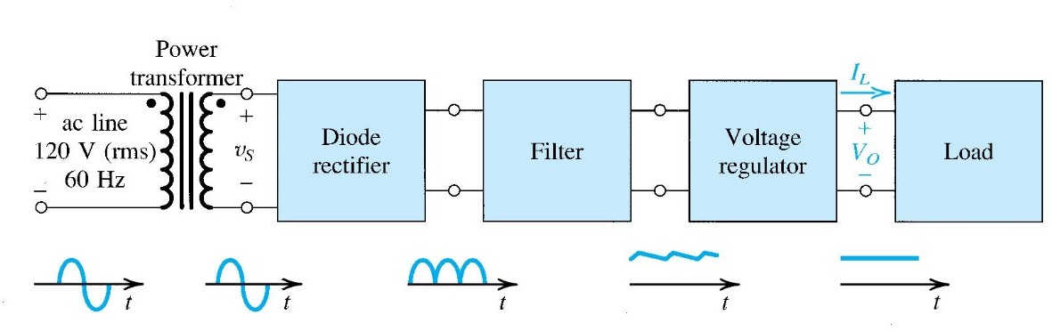
Rectifier Circuits
41
Rectifier circuits are circuits that convert AC signals into DC signals
◉ AC-to-DC power converters:
Sedra/Smith
◉ Also used as peak detectors
AM receivers
Measurement instruments
Rectifiers rely on the unidirectional nature of diodes
◉ Eliminate negative voltages or make them positive

Slide 42
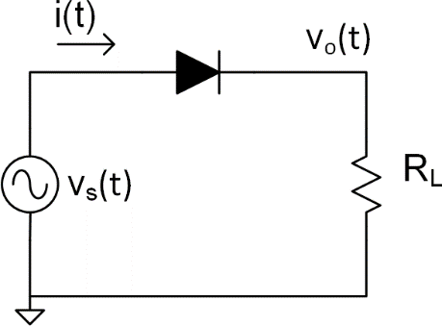
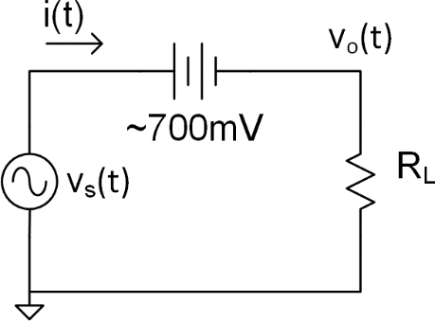
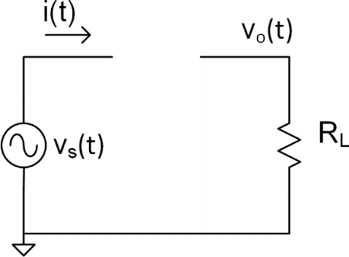
Half-Wave Rectifier
42
Half-wave rectifier
◉ Sinusoidal input, e.g., powerline voltage
◉ Negative half-periods removed
◉ Only positive voltages at rectifier output
For 𝑣𝑣_{𝑠𝑠} 𝑡𝑡 ≥ 𝑉𝑉_{𝑑𝑑,𝑜𝑜𝑜𝑜} ≈ 700 𝑚𝑚𝑉𝑉:
◉ 𝑖𝑖 𝑡𝑡 > 0 𝑝𝑝
◉ 𝑣𝑣_{𝑜𝑜} 𝑡𝑡 = 𝑣𝑣_{𝑠𝑠} 𝑡𝑡
^{− 𝑉𝑉}𝑑𝑑,𝑜𝑜𝑜𝑜
For 𝑣𝑣_{𝑠𝑠} 𝑡𝑡 ≤ 𝑉𝑉_{𝑑𝑑,𝑜𝑜𝑜𝑜} ≈ 700 𝑚𝑚𝑉𝑉:
◉ 𝑖𝑖 𝑡𝑡 = 0 𝑝𝑝
◉ 𝑣𝑣_{𝑜𝑜} 𝑡𝑡 = 0 𝑉𝑉

Slide 43
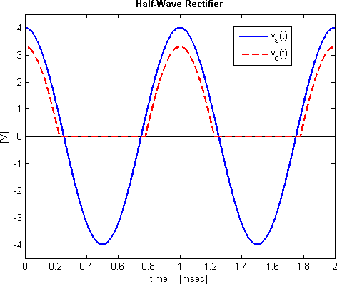



Half-Wave Rectifier
43
~700 𝑚𝑚𝑉𝑉
For 𝑣𝑣_{𝑠𝑠} 𝑡𝑡 ≥ 700 𝑚𝑚𝑉𝑉:
^{𝑣𝑣}𝑜𝑜 𝑡𝑡
= 𝑣𝑣_{𝑠𝑠} 𝑡𝑡 − 700 𝑚𝑚𝑉𝑉
For 𝑣𝑣_{𝑠𝑠} 𝑡𝑡
≤ 700 𝑚𝑚𝑉𝑉:
^{𝑣𝑣}𝑜𝑜 𝑡𝑡
= 0 𝑉𝑉

Slide 44
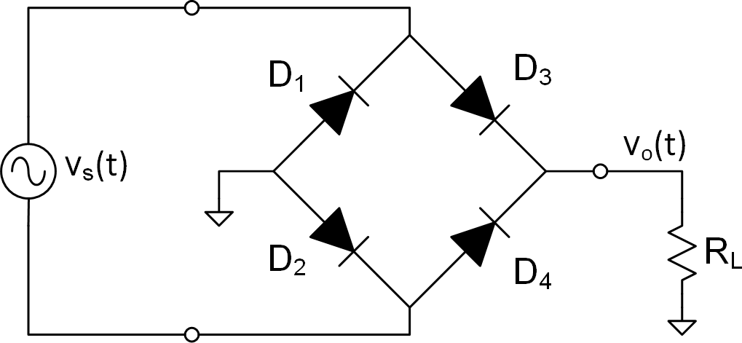
Full-Wave Rectifier
44
Typical goal of a rectifier: extract power from an AC voltage, supply it to a load as a DC voltage
Half-wave rectification is inefficient
◉ Half of the signal – and its energy – is discarded
Full-wave rectification improves efficiency
◉ Negative voltages are not discarded – they are made positive
A diode bridge configuration
Source must be floating
◉ Neither side grounded
◉ Typically the output of a transformer, so not a problem

Slide 45
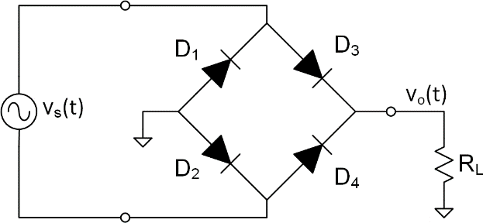
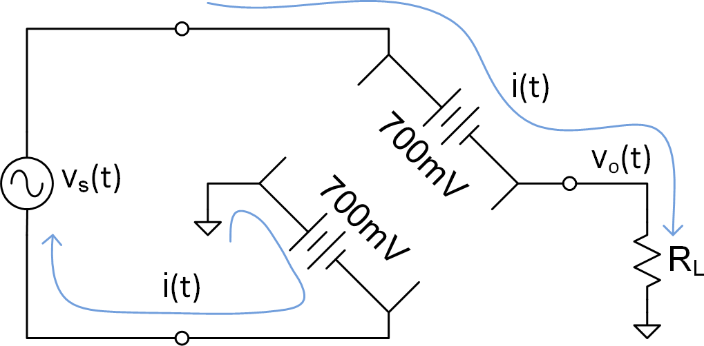
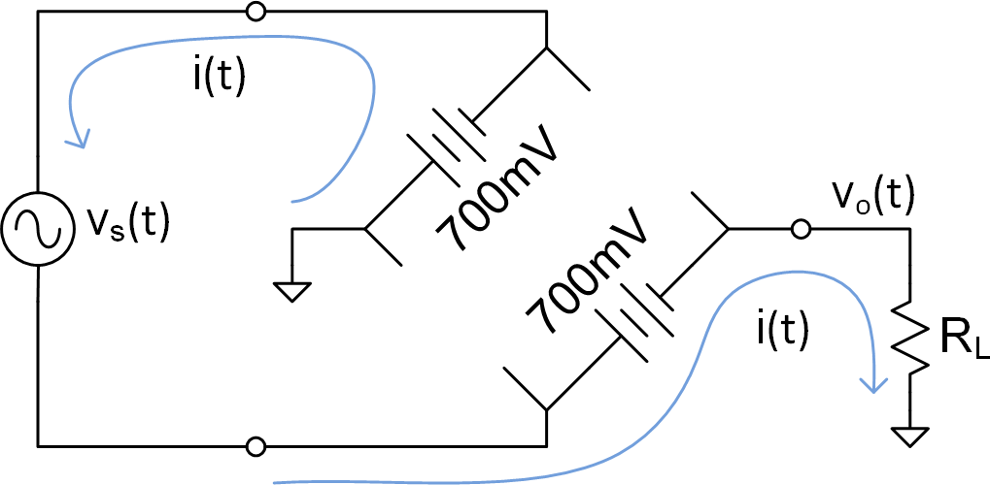
Full-Wave Rectifier
45
For 𝑣𝑣_{𝑠𝑠} 𝑡𝑡 ≥ 2 ⋅ 𝑉𝑉_{𝑑𝑑,𝑜𝑜𝑜𝑜}:
◉ D₂ and D₃ are forward-biased
◉ D₁ and D₄ are reverse-biased
◉ 𝑣𝑣_{𝑜𝑜} 𝑡𝑡 = 𝑣𝑣_{𝑠𝑠} 𝑡𝑡 − 1.4 𝑉𝑉
For 𝑣𝑣_{𝑠𝑠} 𝑡𝑡 ≤ −2 ⋅ 𝑉𝑉_{𝑑𝑑,𝑜𝑜𝑜𝑜}:
◉ D₁ and D₄ are forward-biased
◉ D₂ and D₃ are reverse-biased
◉ 𝑣𝑣_{𝑜𝑜} 𝑡𝑡 = −𝑣𝑣_{𝑠𝑠} 𝑡𝑡 − 1.4 𝑉𝑉

Slide 46
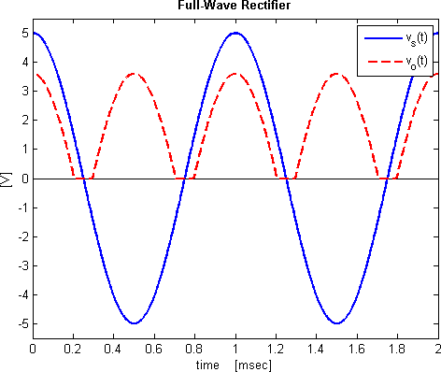



Full-Wave Rectifier
46
For 𝑣𝑣_{𝑠𝑠}
^{𝑣𝑣}𝑜𝑜 𝑡𝑡
𝑡𝑡 ≥ 1.4 𝑉𝑉:
= 𝑣𝑣_{𝑠𝑠} 𝑡𝑡 − 1.4 𝑉𝑉
~1.4 𝑉𝑉
For 𝑣𝑣_{𝑠𝑠} 𝑡𝑡 ≤ 1.4 𝑉𝑉 :
^{𝑣𝑣}𝑜𝑜 𝑡𝑡
= 0 𝑉𝑉

Slide 47
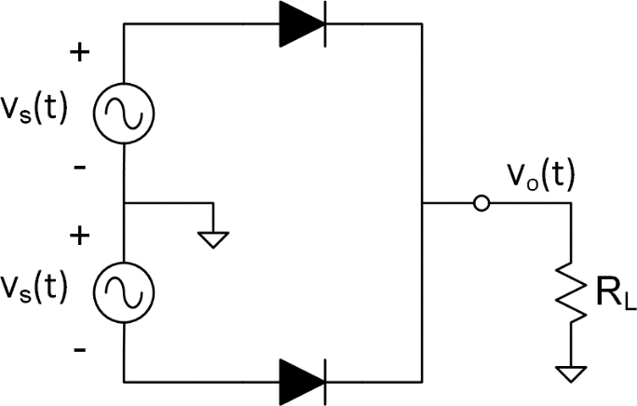
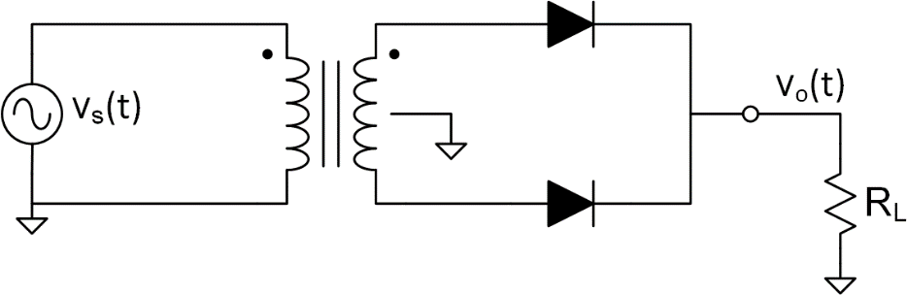
Full-Wave Rectifier – Differential Source
47
If we have a differential source, full-wave rectifier requires only two diodes
Now, only a single diode drop between input and output
𝑣𝑣_{𝑜𝑜} 𝑡𝑡 = 𝑣𝑣_{𝑠𝑠} 𝑡𝑡
^{− 𝑉𝑉}𝑑𝑑,𝑜𝑜𝑜𝑜
Differential source may come from a transformer with a grounded center tap on the secondary winding

Slide 48
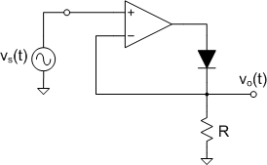
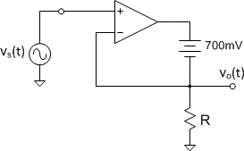
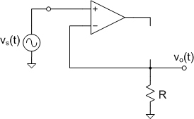

Precision Half-Wave Rectifier
48
A precision rectifier or super diode encloses a diode in an opamp feedback loop
◉ Feedback forces the output equal to the input
◉ Input-to-output diode drop is eliminated
◉ Negative feedback only for positive inputs
For 𝑣𝑣_{𝑠𝑠} 𝑡𝑡 ≥ 0 𝑉𝑉:
◉ Negative feedback path exists
◉ Unity-gain buffer
◉ 𝑣𝑣_{𝑜𝑜}(𝑡𝑡) = 𝑣𝑣_{𝑠𝑠}(𝑡𝑡)
For 𝑣𝑣_{𝑠𝑠} 𝑡𝑡 ≤ 0 𝑉𝑉:
◉ No feedback – output saturates
◉ 𝑣𝑣_{𝑜𝑜} t pulled to ground by resistor
◉ 𝑣𝑣_{𝑜𝑜} 𝑡𝑡 = 0 𝑉𝑉

Slide 49
Smoothing Capacitors & Peak Detectors
49

Slide 50
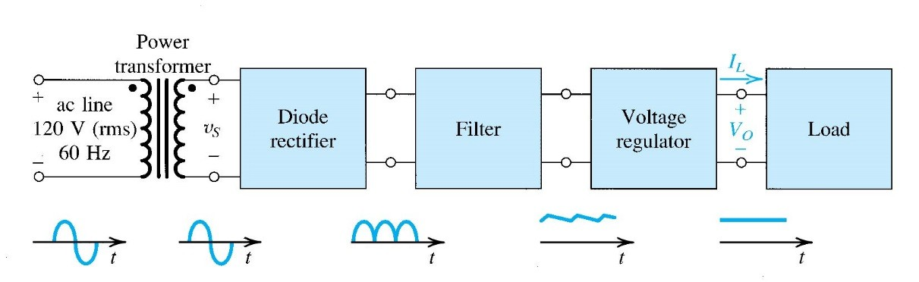
Smoothing Capacitors
50
If our goal is AC-to-DC conversion, rectification is only the first step
◉ Rectified output is positive, but far from DC
Sedra/Smith
A capacitor in parallel with the rectifier’s load resistor will smooth out the output
◉ A smoothing capacitor
◉ A low pass filter to average out the rectified signal
The same circuit can be used for peak detection
◉ Demodulation of an AM radio signal, for example

Slide 51
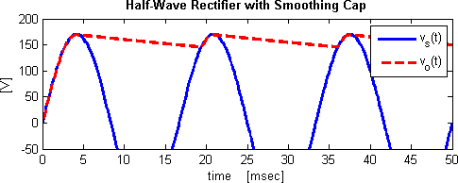
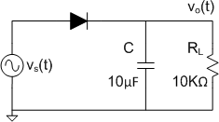
Smoothing Capacitors
51
Add a smoothing capacitor to half-wave rectifier
◉ Input is 60 Hz powerline voltage
When 𝑣𝑣_{𝑜𝑜} ≤ 𝑣𝑣_{𝑠𝑠} − 𝑉𝑉_{𝑑𝑑,𝑜𝑜𝑜𝑜}:
◉ Current flows through the diode
◉ Capacitor charges
When 𝑣𝑣_{𝑠𝑠} ≤ 𝑣𝑣_{𝑜𝑜} + 𝑉𝑉_{𝑑𝑑,𝑜𝑜𝑜𝑜}:
◉ Diode is off
◉ Capacitor discharges at a rate determined by the RC time constant

Slide 52
Smoothing Capacitors
52
Capacitor helps filter or smooth the output
◉ Nearly DC
◉ Remaining AC component is referred to as ripple
Ripple magnitude determined by how far the capacitor can discharge before charging again
◉ Determined by RC time constant
To reduce ripple
◉ Increase the RC time constant
◉ Larger resistor and/or capacitor

Slide 53
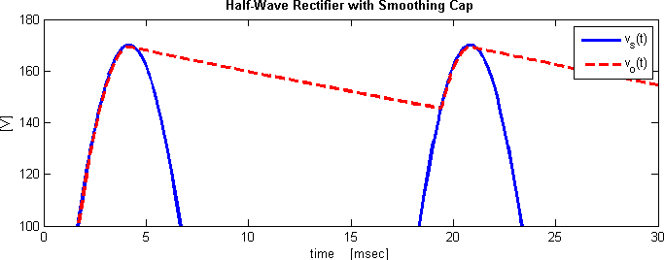
Calculating Ripple – Half Wave Rectifier
53
V_{p}
V_{r}
During discharge:
𝑡𝑡−𝑡𝑡_{𝑝 𝑝}
−
𝑣𝑣_{𝑜𝑜}(𝑡𝑡) = 𝑉𝑉_{𝑝𝑝}𝑒𝑒
𝑅𝑅𝑅𝑅
t_{d}
t_{p}
T
t_{p}+T
𝑉𝑉_{𝑟𝑟}: pk-pk ripple voltage
𝑉𝑉_{𝑝𝑝}: peak input voltage
𝑡𝑡_{𝑝𝑝}: time at input peak
𝑘𝑘: input period
𝑡𝑡_{𝑑𝑑}: capacitor discharge time
Diode modeled as ideal

Slide 54

Calculating Ripple – Half Wave Rectifier
54
𝑉𝑉_{𝑟𝑟} is the difference between the output voltage at 𝑡𝑡 = 𝑡𝑡_{𝑝𝑝} and at 𝑡𝑡 = 𝑡𝑡_{𝑝𝑝} + 𝑡𝑡_{𝑑𝑑}
𝑉𝑉_{𝑟𝑟} = 𝑣𝑣_{𝑜𝑜} 𝑡𝑡_{𝑝𝑝} − 𝑣𝑣_{𝑜𝑜} 𝑡𝑡_{𝑝𝑝} + 𝑡𝑡_{𝑑𝑑}
where
𝑣𝑣_{𝑜𝑜} 𝑡𝑡_{𝑝𝑝} = 𝑉𝑉_{𝑝𝑝} and 𝑣𝑣_{𝑜𝑜} 𝑡𝑡_{𝑝𝑝} + 𝑡𝑡_{𝑑𝑑} = 𝑉𝑉_{𝑝𝑝}𝑒𝑒
𝑡𝑡_{𝑑𝑑}
−
𝑅𝑅𝑅𝑅
so
₋ 𝑡𝑡_{𝑑𝑑 −} 𝑡𝑡_{𝑑𝑑}
𝑅𝑅𝑅𝑅 = 𝑉𝑉_{𝑝𝑝}
𝑉𝑉_{𝑟𝑟} = 𝑉𝑉_{𝑝𝑝} − 𝑉𝑉_{𝑝𝑝}𝑒𝑒 1 − 𝑒𝑒
𝑅𝑅𝑅𝑅
Problem is, we do not know 𝑡𝑡_{𝑑𝑑}
◉ Could calculate it, but, instead, assume the following:
𝜏𝜏 = 𝑅𝑅𝐶𝐶 ≫ 𝑘𝑘
From which it follows that
◉ 𝑉𝑉_{𝑟𝑟} ≪ 𝑉𝑉_{𝑝𝑝}
◉ 𝑡𝑡_{𝑑𝑑} ≈ 𝑘𝑘
◉ Discharge current is approximately constant:
𝑖𝑖 𝑡𝑡
𝑉𝑉_{𝑝𝑝}
≈ 𝑡𝑡 ≤ 𝑡𝑡 ≤ 𝑡𝑡 + 𝑡𝑡
𝑅𝑅
𝑝𝑝 𝑝𝑝 𝑑𝑑

Slide 55
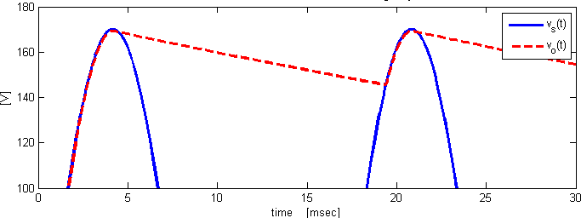
Approximating Ripple – Half Wave Rectifier
55
Recall that the change in voltage across a capacitor discharged at a constant current is
𝐼𝐼 ⋅ 𝑡𝑡
𝑉𝑉 =
𝐶𝐶
Using our approximations for current and discharge time gives an approximation for the ripple voltage:
𝑉𝑉_{𝑝𝑝} ⋅ 𝑘𝑘 𝑉𝑉_{𝑝𝑝}
𝑉𝑉_{𝑟𝑟} ≈
=
𝑓𝑓𝑅𝑅𝐶𝐶
𝑅𝑅𝐶𝐶
V_{p}
V
ripple
𝑉𝑉_{𝑝𝑝} ⋅ 𝑘𝑘
^{𝑉𝑉}𝑟𝑟𝑟𝑟𝑝𝑝𝑝𝑝𝑟𝑟𝑟𝑟 ≈ _{𝑅𝑅𝐶𝐶}

